Slide 1
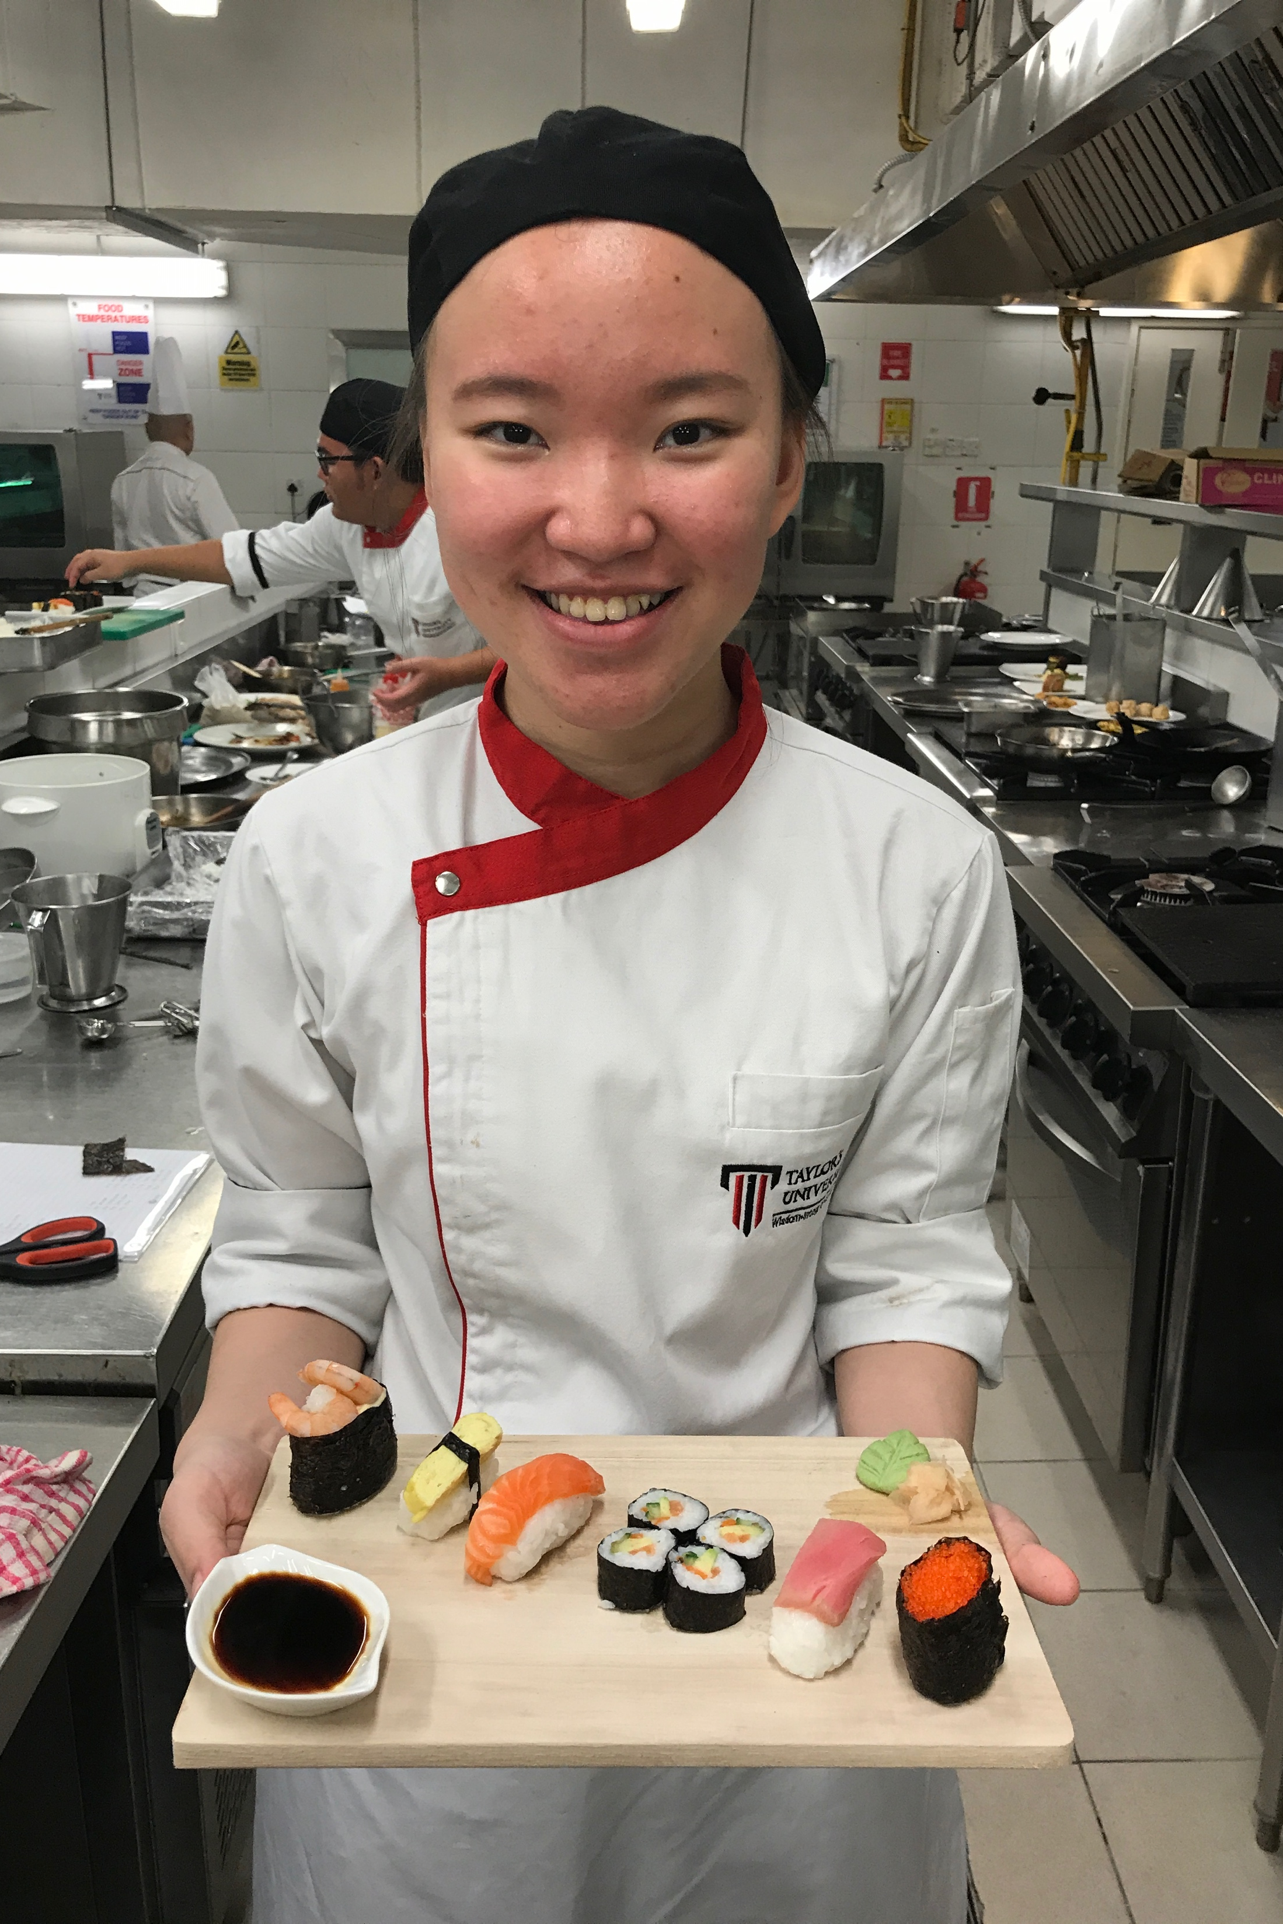
kitchen operation 3
reflective learning assignment
Severin Noverina
BC 14 Group 3
0328234

Slide 2
challenges / difficulties & how i overcome
During my learning process I struggle a bit on finding the tastes of Asian food that we are not familiar with, to overcome that I do my own research by going to Asian restaurants and internet research
I also challenged when it comes to plating, on how to create a fine dining standard plating with the traditional dishes of every country that we have created, this makes me research more on plating and garnishing and that is how I overcome this challenge
This time we had to do our own cooking without lecturer demo which is different compare to last semester and we have to be self-reliant with skills that we have developed previously. It is just matter of time to adjust the situation and ambience in kitchen

Slide 3
. What areas did you think you performed well in within this subject?
    i think i did well in managing the task assign to to myself including meeting the time allocation and the standard required
I would reward myself 8 out of 10 due to to contibution that I managed to gave for the dishes throughout this semester. But still i made few mistake and lacks in few parts including the seasoning that is not strong enough which the reason is i think i haven’t give my best

Slide 4
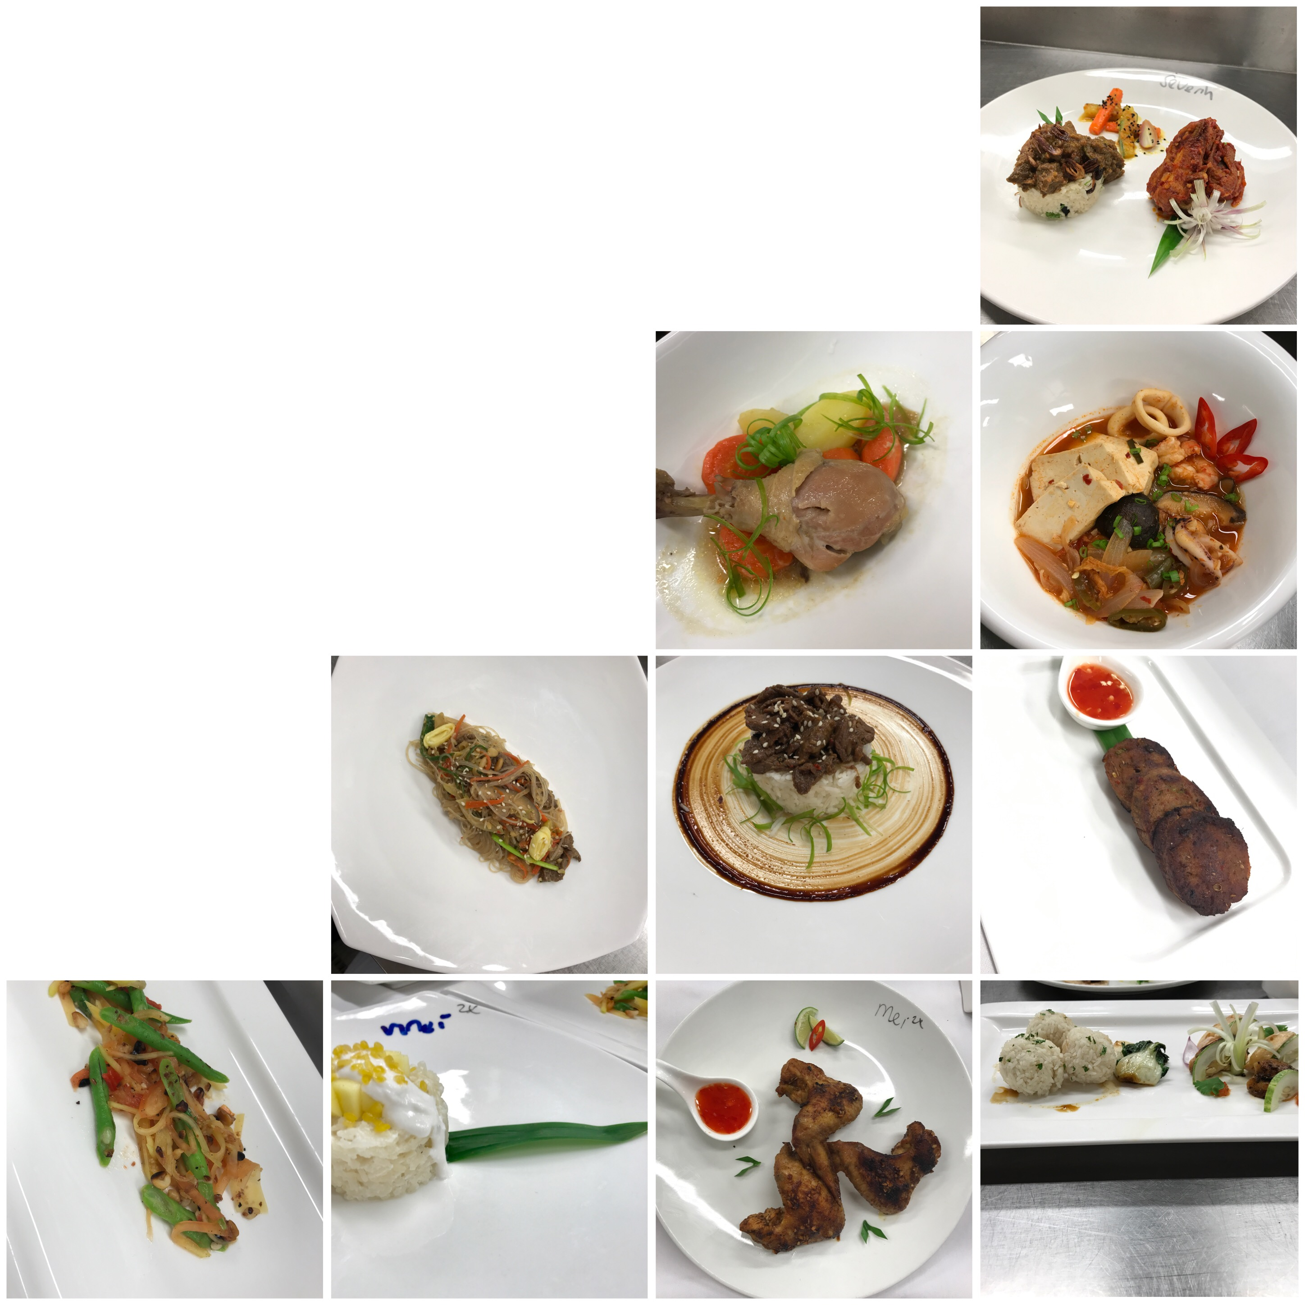
BENEFIT
I do think this module will be useful for my future career as we learned how to produce food for the restaurant & it develop basic skills that we learned to another level for us to use in the future.
Throughout the semester we also learned the importance of safety handling & usage of ingredients and equipment, communication & teamwork in this field. As i plan to do my career related to kitchen, hence these skills are important for me.

Slide 5
In this practical class, i feel less egoistic because the work we did involved in group form of two which require communication and teamwork. It helped me to feel kitchen works flow and help me to adjust with the environment and ambience. In this subject I always excited when it comes to kitchen practical as it is the purpose of me taking this programme
THANK YOU FOR READING CHEF!

